Slide 1








TEXT ANALYSIS ON BREAST CANCER USING REDDIT POST
IST 736 TEXT MINING FINAL PROJECT
Team Members:
-Sravan Kumar Mangalagiri
-Kavya Darsi
-Abirami Rajalingam

Slide 2

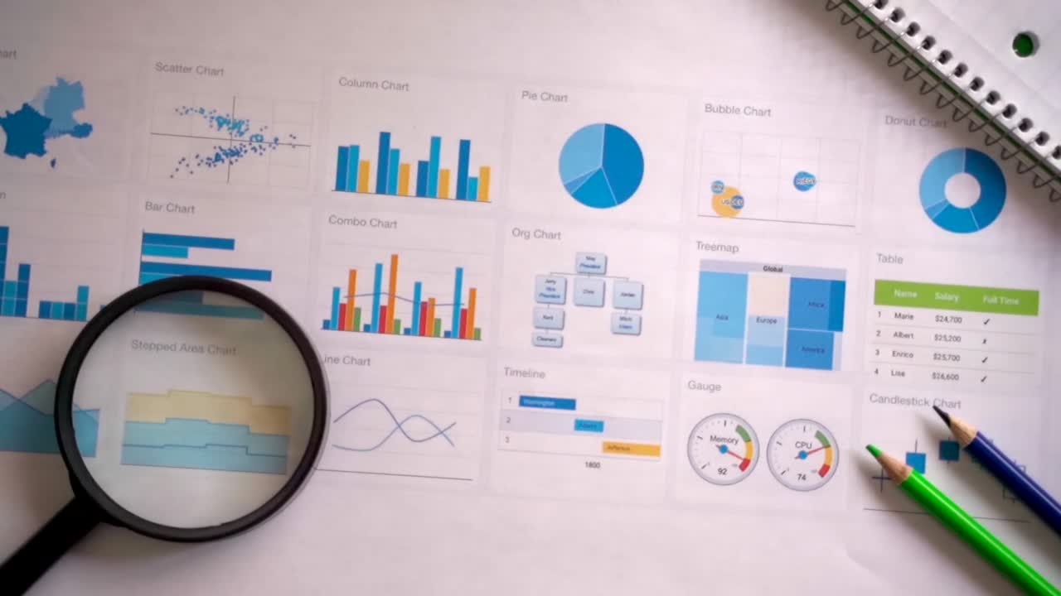
Agenda
Problem Statement
Data Description
Text Mining methodologies
Challenges
Ethical Concerns

Slide 3
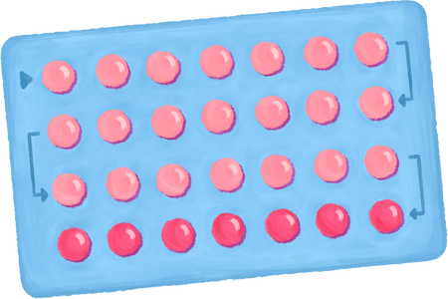




Problem Statement
Highlight the need to understand common concerns, questions, and discussions about breast cancer on social media platforms like Reddit.
Helping doctors to create a better understanding of public questions regarding the cancer treatment
Assisting in pinpointing public needs by analyzing the types of questions asked and the responses given.

Slide 4

Data Description
•Dataset contains subreddit data of questions and their respective comments on breast cancer posted by the public
• Once merged with its corresponding questions the total dataset comprises 65506 rows
•Every question contains comments, title, score, and controversiality value.
•Public discussion/conversation on breast cancer its symptoms, post-treatment procedure, personal stories, etc.,
•Brings motivation to the project by being a real-time use case

Slide 5



Text Mining Methods
Data Profiling
Modelling
Stopwords
Lemmatization
Balancing Data
Clustering (unsupervised)
Topic Modelling
Question - Answer Model
Sentiment Analysis
Vectorization
Model Evaluation
TFIDF
Count Vectorizer
Word2Vec
Error Analysis
Confusion Matrix
Text Specific Evaluation

Slide 6

Problem Modeling
Topic Modelling
Topic modeling algorithms, like Latent Dirichlet Allocation (LDA) can be utilized to extract and categorize predominant themes from the vast and varied discussions about breast cancer questions on Reddit. This process involves analyzing the text data to identify clusters of words that frequently occur together, which are then interpreted as topics.
Sentiment Analysis
To understand the emotional undertones associated with different discussion themes. This helps in identifying the most emotionally charged topics, such as fear, hope, or solidarity, within the breast cancer discussion space.
Question Answer Modelling
Question-answer modeling, using NLP techniques such as BERT can be trained to comprehend and respond accurately to a wide array of inquiries about breast cancer posted on Reddit. This involves the model parsing through large volumes of text data to understand the context and nuances of questions raised by users, and then generating appropriate and informative responses.

Slide 7
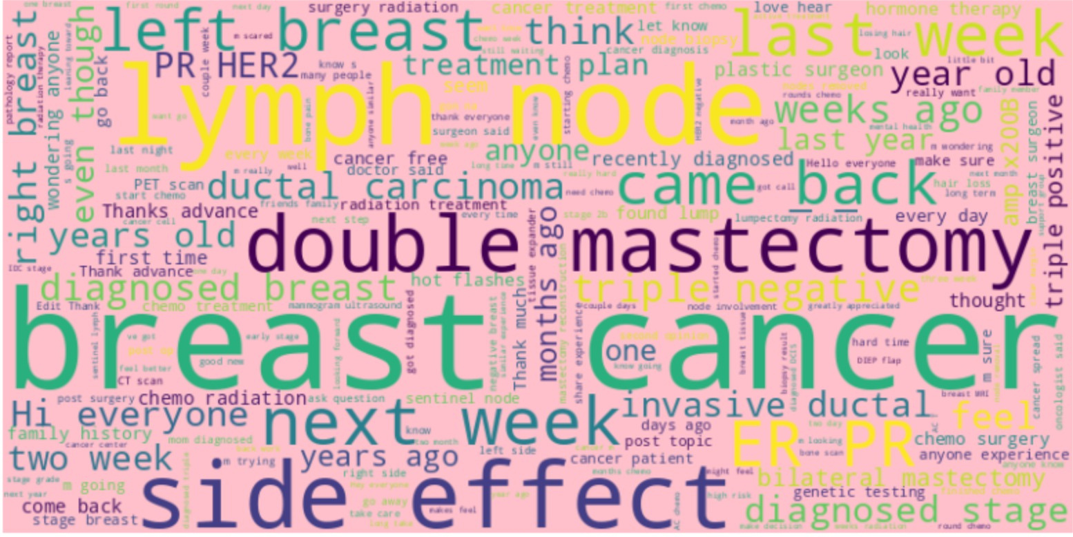
Most Common Words in Questions

Slide 8
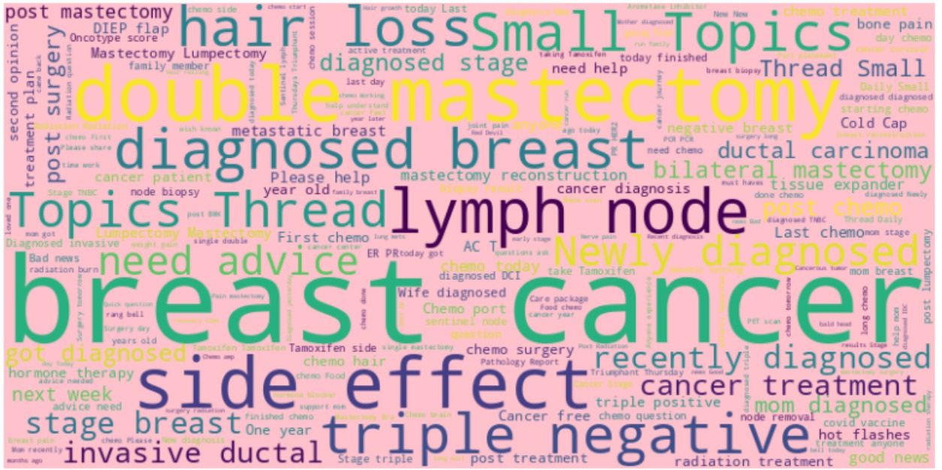
Most Common Words in Comments

Slide 9

Challenges
Reddit comments often include slang, jargon, and colloquial language, which can be difficult to interpret and analyze accurately.
Reddit data includes text, links, images, and sometimes videos, which add complexity Also, Comments may contain irrelevant or off-topic information, requiring effective filtering and noise reduction techniques.
Capturing the nuances of sentiment in text, especially when it involves sarcasm, irony or anger can be challenging. Furthermore, Comments may contain mixed emotions or complex sentiment patterns that are hard to categorize.

Slide 10

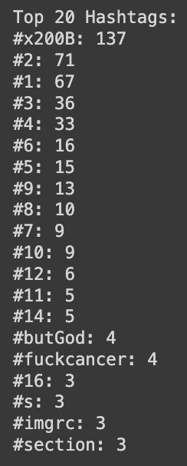
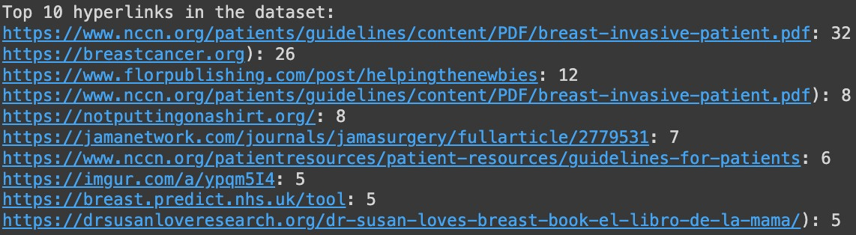
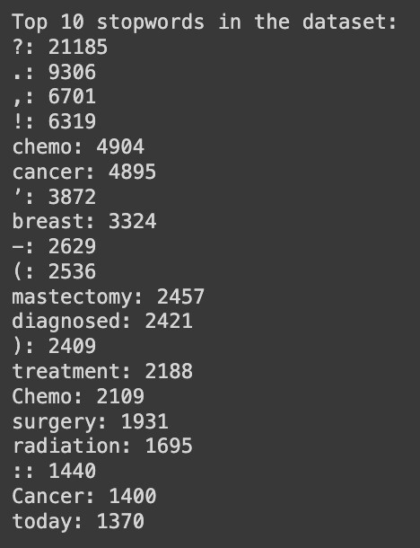

Slide 11

Ethical Concerns
Discussions about breast cancer might include identifiable personal health information. Ensuring that this data is fully anonymized to protect individuals' privacy is crucial.
There's a risk of propagating misinformation if the NLP model inaccurately represents or generalizes the content of the discussions.
Ensuring that the model doesn't overrepresent or underrepresent certain viewpoints or experiences within the breast cancer community.
The project should aim to contribute positively to the understanding of breast cancer, offering insights that could support patients, caregivers, or healthcare professionals.

Slide 12



THANK YOU

